Slide 1



Agentic
Multimodal Commerce Platform
Conversational Product Discovery, Multilingual Retrieval & Transparent Billing - Driven by an Agentic, Explainable AI stack.
Contributors
Nishchay Tiwari
Akilesh
Jaydeep Kumar
Shivanshu Soni
Lalith Kumar
Arindam Nag

Slide 2



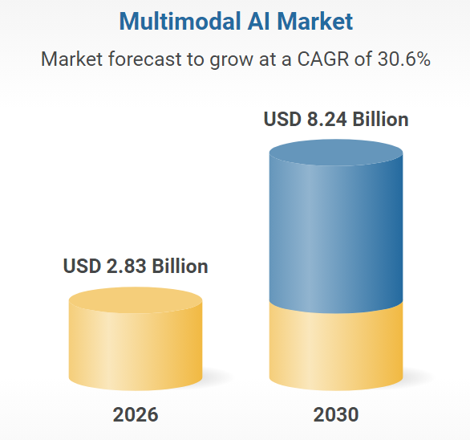

Agentic
Multimodal Commerce Platform
Problem Statement
Current commerce assistants operate in silos—treating text, images, and data as isolated inputs. This lack of "multimodal reasoning" leads to inaccurate search results and "black-box" billing that erodes user trust.

Slide 3

Agentic
Multimodal Commerce Platform
Our Solution
The Agentic Multimodal Commerce Platform is a research and engineering initiative that lets shoppers find products and complete checkout-style flows using natural language (including multiple languages) and product images, not just keyword search.
Today’s commerce assistants often treat text and images in isolation, treat OCR as plain text without product semantics, and automate billing without enough transparency. This project builds a single conversational system that reasons across modalities, adapts its workflow dynamically, and explains what it matched and why—so it can be taken seriously in real retail and e-commerce settings.

Slide 4



Agentic
Multimodal Commerce Platform
This project is built on an agentic architecture featuring dynamic routing that is explainable, multilingual, and safe by design—aligned with production-grade AI deployment in e-commerce.
Issues We Tried To Solve
By Implementing
Discovery is text-only or image-only, rarely both in one flow
OCR yields text, not product semantics (brand, size, variant)
Weak multilingual support
Billing feels like a black box
Brittle, linear AI pipelines
Unified chat + image upload with orchestrated multimodal retrieval
Advanced Named OCR (ANOCR) for structured entities and confidence
Translation to a canonical language plus multilingual embeddings
Billing & Explanation Agents with RAG-backed rationale
Explicit nodes, edges, conditions, retries, and fall backs

Slide 5

Agentic
Multimodal Commerce Platform
Tech Stacks & Application
Streamlit | Conversational UI: chat, image upload, streaming responses, confirmation controls
LangGraph runtime | Python application wiring graph definition, state, and execution
Agent layer | Pluggable agents: conversation manager, guardrails, intent, retrieval, vision, ANOCR, translation, billing, explanation
FalkorDB | Vector store for multimodal RAG (text, image, OCR, multilingual embeddings)
Config / prompts | Model endpoints, thresholds, safety rules, and prompt templates
Tests & eval | Unit/integration tests and optional retrieval-quality checks
LLMs | LLaMA, Mistral, Mixtral, Phi
Text embeddings | Sentence-Transformers, BGE, Instructor
Image embeddings | CLIP / SigLIP

Slide 6

Agentic
Multimodal Commerce Platform
Agentic orchestration
A conversation manager coordinates specialized agents; workflows are not a single fixed chain
LangGraph control flow
Nodes (agents/steps), edges (transitions), and conditions (which path to take) are first-class; supports loops for retry and user confirmation
Multimodal RAG
FalkorDB stores text, image, OCR, and multilingual vectors for retrieval-augmented grounding.
Confidence-aware automation
High / medium / low confidence gates drive billing, user confirmation, or fallback—not blind automation.
Guardrails
Input validation, policy constraints, and thresholds before irreversible actions (e.g. billing).
Open-source stack
Python, Streamlit, LangGraph, open LLMs and embedding models, enabling reproducibility and cost control.
Logical
Components

Slide 7






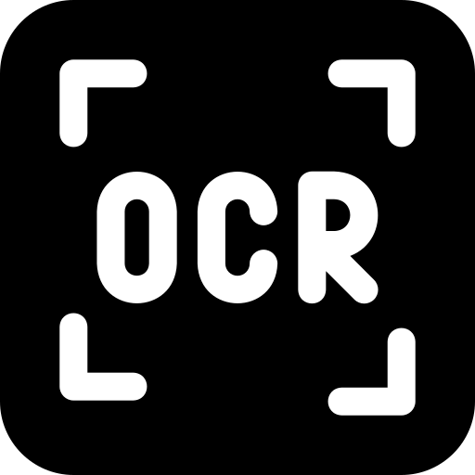




Agentic
Multimodal Commerce Platform
Agents & Their Responsibilities
Conversation Manager | Session state, intent (text vs image path), LangGraph route selection
Guardrails | Validate inputs; enforce product/policy rules; confidence thresholds for automation
Intent classifier | Distinguish text query vs image scan and downstream branches
Text retrieval | Multilingual query embedding; semantic search in FalkorDB; ranked candidates
Vision search | Image embedding; similarity search in FalkorDB
ANOCR | Extract brand, product name, size, attributes; structured entities + confidence
Translation | Normalize text to a canonical language for search and responses
Billing & validation | Price, tax, discount; invoice generation
Explanation | Use RAG context to justify decisions to the user

Slide 8
Agentic
Multimodal Commerce Platform
Nodes & Control Flow
Intent
Classifier
Chat Input
Conversation Manager
Guardrails
Vision Search
Text
Retrieval
FalkorDB
Confidence Evaluation
Retry
Billing
High
Medium
Low
Billing
User Confirmation
Explain
Response
Translation
ANOCR
Fallback

Slide 9


Agentic
Multimodal Commerce Platform
Use case
Retail & e-commerce teams prototyping conversational and multimodal search without vendor lock-in.
Global or multilingual catalogs where queries and product copy mix languages.
Operations that need auditable steps: why a SKU was chosen, what confidence was, and what the user confirmed.
Research and coursework (IITR) demonstrating modern RAG, agents, and graph-based orchestration on realistic commerce scenarios.
USP
Faster checkout
Reduced manual intervention
Multilingual global support
Enterprise-grade trust and safety

Slide 10
Agentic
Multimodal Commerce Platform

